Slide 1

Drug Discovery: History and Paradigms
Jeremy Yang, Associate Instructor IU School of Informatics and Computing
Instructor: Prof. Joanne Luciano
Based on slides by Prof. David Wild, 2013 edition of course.
DATA SCIENCE FOR DRUG DISCOVERY, HEALTH AND TRANSLATIONAL MEDICINE (DSDHT) INFO I-590
Notes:
Welcome back to "Data Science in Drug Discovery, Health and Translational Medicine", Module 5, "The Drug Discovery Process", lesson 1, "History and paradigms of drug discovery". I am Jeremy Yang, associate instructor for this edition of the course. Prof Luciano has invited me to present this module and the next three, which will cover bioinformatics and cheminformatics as applied to medicine and drug discovery, and I am delighted to do so.

Slide 2
Drug discovery history and paradigms: DSDHT context & relevance
DATA SCIENCE FOR DRUG DISCOVERY, HEALTH AND TRANSLATIONAL MEDICINE (DSDHT) INFO I-590
Q1 How can data science help researchers find new drugs and reuse old ones?
Module 5:
The drug discovery process
Module 6:
Bioinformatics introduction
Module 7:
Bioinformatics and medicine
Module 8:
Cheminformatics
Data science

Slide 3
Drug discovery paradigms
Empirical
~200k BCE+
Vitamins, vaccines & antibiotics
~1800+
Rational
~1960+
Integrative
~2010+
Context: Public health, science, medicine
Why care about history? All paradigms active now.

Slide 4

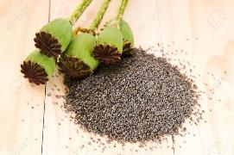
Drug discovery paradigms: Empirical
~200k BCE (human existence)
754 - First pharmacy opened in Baghdad
1800s – major pharmas, mass production
Natural products, traditional medicines
Limited disease scope: pain relief, infectious disease
poppy flower, pods, seeds

Slide 5
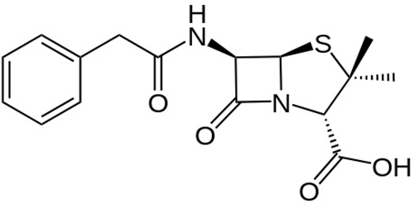
Drug discovery paradigms: Vitamins, vaccines & antibiotics
~1800+
Science: nutrition, immunology, microbiology
Vitamin deficiency diseases: scurvy (C), pellagra (B3), beriberi (B1), rickets (D)
Malnutrition, infectious diseases predominant risks
Penicillin, polio vaccine & other “wonder drugs”
penicillin

Slide 6
Drug discovery paradigms: Vitamins, vaccines & antibiotics
A few statistics
Black Death, a.k.a. Bubonic Plague
1340-1400
~100 million deaths, ⅓ European population
1918 influenza epidemic
~20 million deaths, ~1% world population.
Life expectancy
Infant mortality (death in first year)

Slide 7
Drug discovery paradigms: Vitamins, vaccines & antibiotics
A few statistics
Black Death, a.k.a. Bubonic Plague
1340-1400
~100 million deaths, ⅓ European population
1918 influenza epidemic
~20 million deaths, ~1% world population.
Life expectancy
Infant mortality (death in first year)
Country | Year | Life expectancy | Infant mortality
Canada | 1900 | 48 | 18.7%
 | 1950 | 68 | 4.1%
 | 2000 | 79 | 0.5%
China | 1900 | 32
 | 1950 | 40 | 19.5%
 | 2000 | 72 | 3.0%
USA | 1900 | 49
 | 1950 | 68 | 3.3%
 | 2000 | 77 | 0.7%
data from
gapminder.org

Slide 8
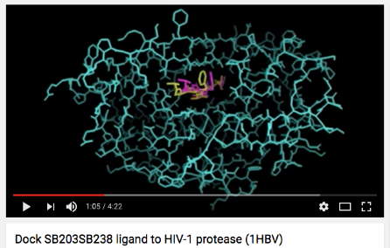
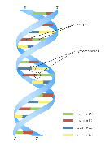
Drug discovery paradigms: Rational
~1960+
Scientific: molecular biology, computer science
“Lock and key” concept: target protein, selective drug
Some big successes (e.g. HIV)
Expanded disease scope: metabolic, cancer, mental

Slide 9

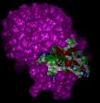
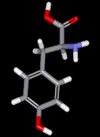
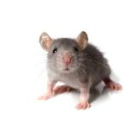
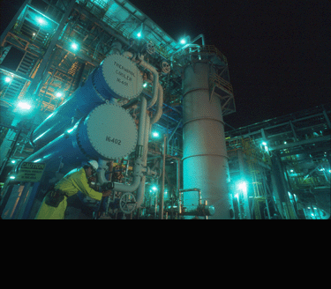
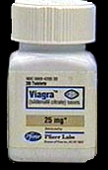
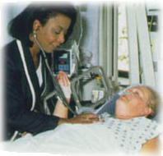
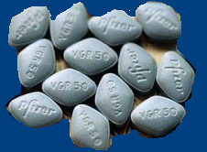
Rational Drug Discovery "Pipeline"
Identify disease
Find a drug effective
against disease protein
(2-5 years)
Isolate protein
involved in
disease (2-5 years)
CLINICAL TRIALS
Preclinical testing
(1-3 years)
Human clinical trials
(2-10 years)
Formulation &
Scale-up
File IND
DISCOVERY
File NDA
DEVELOPMENT
FDA approval
(2-3 years)
MARKETING >>

Slide 10
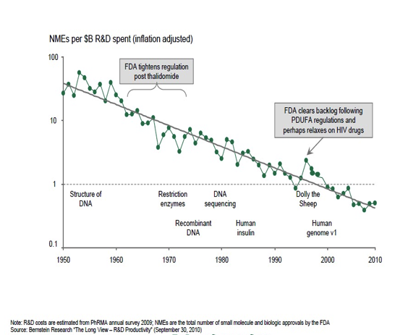
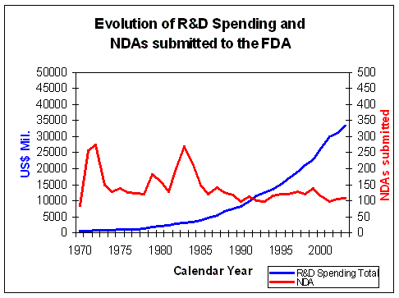
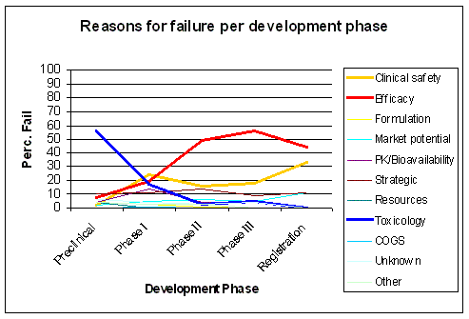
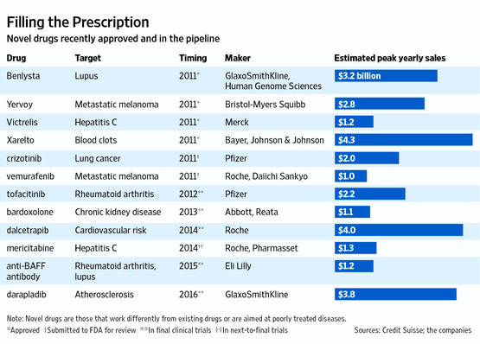
Stagnation in new drug therapies
Graphs taken from Vanosta.be

Slide 11
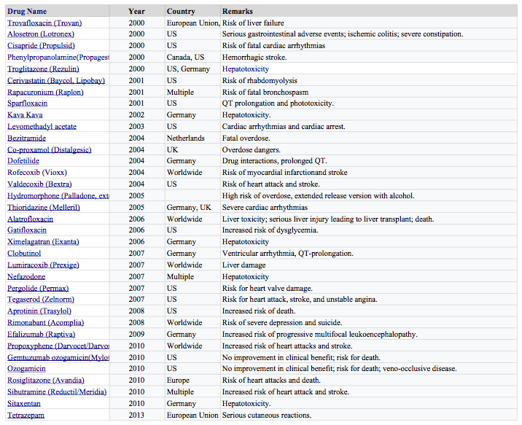
Drug Withdrawals
Since 2000, due to safety and efficacy alerts.
Evidence of flawed system?
Withdrawal information taken from http://en.wikipedia.org/wiki/List_of_withdrawn_drugs.

Slide 12
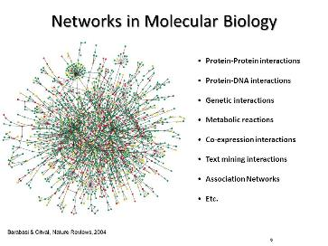
Drug discovery paradigms: Integrative
~2010+
Science and technology
Systems biology
Informatics
Data science
Data integration
Molecular
Clinical
Genomic
Bibliological
Epidemiological
Integrates other paradigms
Barabasi and Oltvai, Nature Reviews, 2004

Slide 13
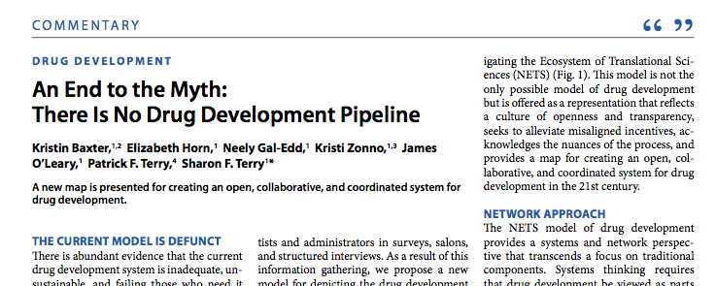
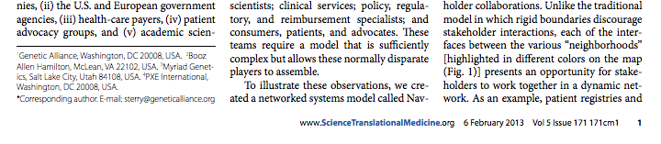
Rational Drug Discovery "Pipeline" ...
... a myth?

Slide 14
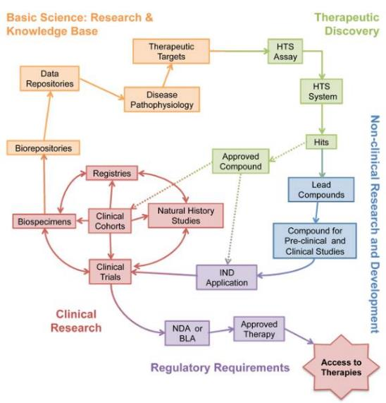
Navigating the Ecosystem of Translational Sciences
http://www.geneticalliance.org/programs/biotrust/nets

Slide 15
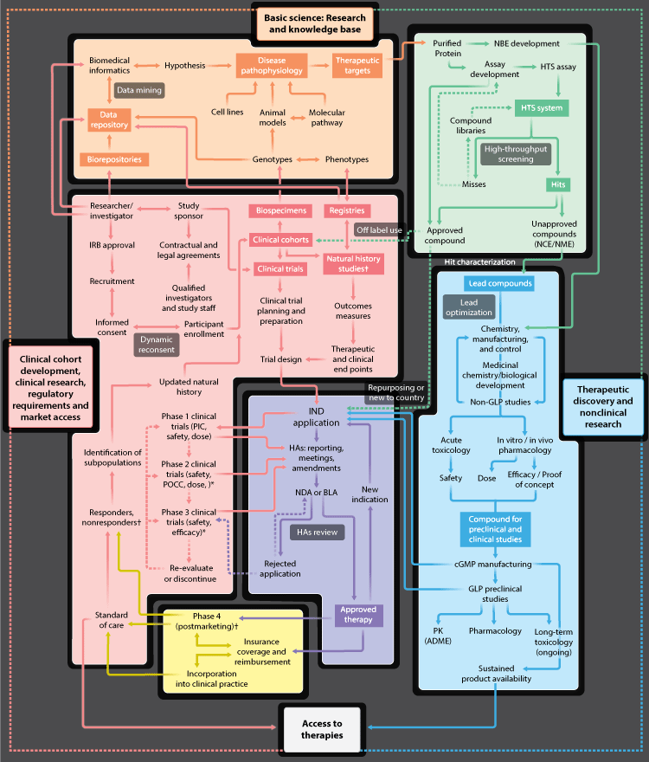

Navigating the Ecosystem of Translational Sciences
http://www.geneticalliance.org/programs/biotrust/nets

Slide 16
Navigating the Ecosystem of Translational Sciences
Collaboration and feedback loops among: clinical and non-clinical research, basic science and data science

Slide 17
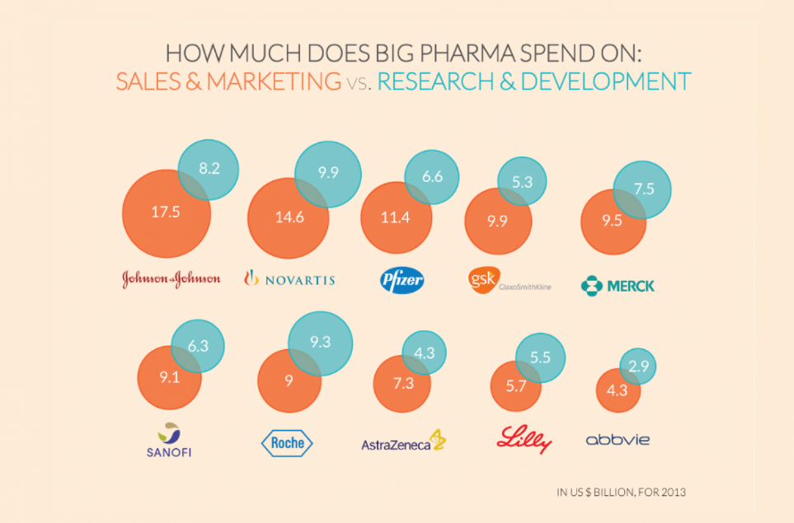

Slide 18
Drug Discovery Paradigms: Take home messages
Historically, finding new medicines was empirical (i.e. natural products, traditional medicine).
Science has produced “wonder drugs” such as antibiotics and vaccines. But "wonder drugs" do not exist for all conditions.
Molecular biology has transformed drug discovery into a rational design process – when it works. Some great successes, but process may have “run out of steam”.
The current rational drug discovery & development process is lengthy, expensive and risky.
New integrative paradigm combines systems biology and data science.

